Slide 1


Florida International University
PokerBots 2025
Lesson 2: Probability Fundamentals

Slide 2



Thank you sponsors
GTO Wizard & Octopi Poker

Slide 3

Today’s Agenda
Pre-Lecture Games
What is a game?
Pure vs Mixed Strategies
Nash Equilibrium
Game Theory in Poker
Exploitative vs Equilibrium Play
Bayesian Belief Updating

Slide 4

Game #1 - Number Guess
Everyone chooses a number between 0 to 1000
The target is 2/3rds of the average guess
Closest guess to the target wins.

Slide 5

Game #1 - Key Takeaways
“Levels” of reasoning
“I think that they think that I think…”
This is the same concept used by players when adjusting their strategies in poker based on “beliefs” about opponents.
Is there any value in picking above 667?

Slide 6
Game #2 - Break Even Bluff Frequency
What opponent fold rate makes a 50% pot river bluff break even (EV = 0)?
25%, 33%, 50%, 66%

Slide 7

Game #2: Solution
Different Bet Sizes
EV(calling a bet) = P(win) x pot_size - P(lose) x continue_cost
Updated Formula:
EV(bluff) = P(fold) x pot_size - P(call) x (bet_size)

Slide 8
Game #2: Solution… continued
Note that: P(call) = 1 - P(fold) & P(win) = 1 - P(lose)
Step 1: Set EV to zero (indifference condition)
0 = P(fold) x pot_size - P(call) x (bet_size)
Step 2: Set pot_size = 2 and bet_size = 1 (50% pot)
0 = P(fold) x 2 - (1 - P(fold)) x 1
Step 3: Solve for P(fold)
0 = 2P(fold) - 1 + P(fold))
P(fold) = 1/3
Interpretation:
Villain Calling your 50% pot_size bluff is your break-even point
P(fold) > 33% = +EV
P(fold) < 33% = -EV

Slide 9

Counting Outs Exercise
How about different bluff sizes?
EV(bluff) = P(fold) x pot_size - (1 - P(fold)) x (bet_size)
33% Sizing:
0 = P(fold) x 3 - (1 - P(fold)) x 1
P(fold) = 24.8%
50% Sizing:
0 = P(fold) x 2 - (1 - P(fold)) x 1
P(fold) = 33.3%
100% Sizing:
0 = P(fold) x 1 - (1 - P(fold)) x 1
P(fold) = 50%
150% Sizing:
0 = P(fold) x 1 - (1 - P(fold)) x 1.5
P(fold) = 60%
Idea - the bigger you bluff the more your opponent has to fold for you to profit on that decision overtime

Slide 10
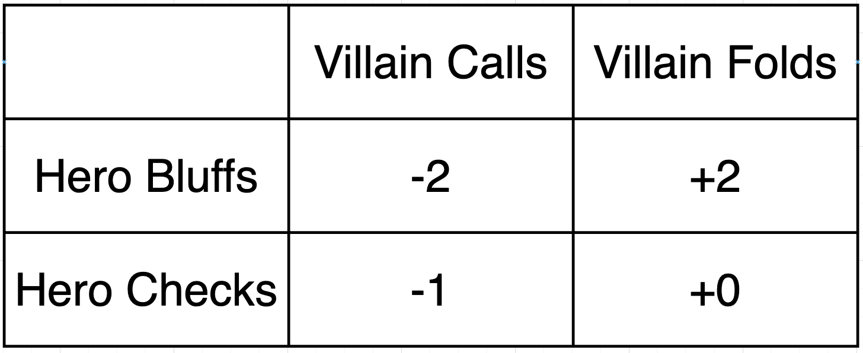
Zero-Sum Framework
One player’s chip gain = other’s chip loss
Scenario:
- Each player ante 1
- Hero knows they has the worst hand possible so they bluffs 50%
Hero Payoff Matrix

Slide 11

Kuhn Poker - Introduction
3-card deck: J, Q, K
Each player antes 1 chip, and dealt 1 card
Single betting round: 1 chip per player (who ever has the highest card wins)
Value:
Limited action space but, valuable to analyze and grasp strategic insights applied in full-deck poker.

Slide 12
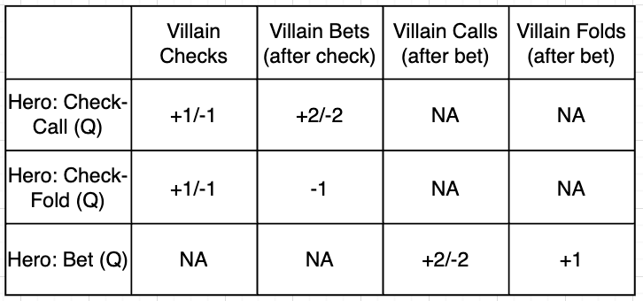
Kuhn Poker - Strategy Profiles and Payoffs
Hero is dealt a Queen, what should they do?
Mixed Strategy - assign probabilities to each individual strategy
What mixed-strategy is the best?

Slide 13

Kuhn Poker - Indifference Conditions
Conditions:
- Villain only calls with K, so we have to decide when to bluff villain off a Q if they are dealt one.
Setup:
Let p = P(bluff | queen)
Villain must be indifferent (between call or fold), so EV(villain_call) = EV(villain_fold)
EV(villain_calls) = -2
EV(villain_folds) = +2
So EV(bluff) = p x 2 - ((1-p) x -2)
EV(check) = 0 (33% win, 33% lose, 33% tie)
Setting EV(bluff) = 0 we get p = 0.5
Result - Hero should bluff with a Queen 50% of the time.

Slide 14
Kuhn Poker - True Model
BUT the previous model was simplistic.
You will always want to bet with a King and sometimes with a Jack as a bluff.
Factoring in bluffs and value-bets you get the true mix of 1/3rd bluff, 2/3rds check holding a Queen.
For full multi-card derivation using indifference conditions:
https://aipokertutorial.com/toy-poker-games/

Slide 15
Pure vs. Mixed Strategies
Pure
Fixed mapping, always bet Kx on the flop
Mixed
Bet Kx 70% of the time, check 30%
Example: “Mixing” bluffs on the river prevents opponents from auto-folding or auto-calling
Idea: playing mixed strategies reduces predictability and exploitation (essential to game-theoretic play).

Slide 16
Mixed Strategy - Universal Hashing
Each hash function has a pathological dataset, which maps every input to the same hashed value.
Hash-flooding attack: adversary crafts pathological dataset and sends it to a server forcing O(n) lookups. With huge amounts of data this degrades the service.
Solution:
Universal hashing, instead of using one hash function you assign a probability to each of k-hash functions being chosen. This mixing makes the adversaries not be able to “crack” your strategy.
This also better mimics “Simple Random Hashing”, each value is equally likely to go to any of N buckets (theoretically optimal but not possible in practice). Why?

Slide 17
RPS Analogy
Pure strategies, either rock, paper, or scissors leads to easy exploitation.
Mixed, 33% for each choice yields 0 expected loss (Nash Eq)
This is the same core idea between “balancing” value with bluffs in poker. If you only do one or the other, opponents can easily adjust with the best counter-strategy.

Slide 18
Nash Equilibrium - Revisted
Core Idea:
- No player can increase their payoff by switching strategies (becomes a self-maintaining state).
- Each player “agrees” to continue playing Nash since there is no value in deviating.
- Every other strategy that is not Nash, can be theoretically “exploited”.
Nash’s Guarantee:
- All finite games posses at least one mixed NE
BUT this is extremely extremely hard to solve deterministically for big games (bounded by the number of actions).

Slide 19
Scaling Nash Equilibrium - Using Linear Programming
LP:
- Used to solve problems where you have linear parameters subject to linear constraints.
Solving Poker Using LP:
- Represent strategies as probability vectors
- Constraints enforce indifference accross actions
- Objective: maximize hero’s guaranteed EV
Node-Locking:
- Fix strategies at selected nodes (common bet/ raise lines), solve the subgame to converge to the best counter-strategy

Slide 20
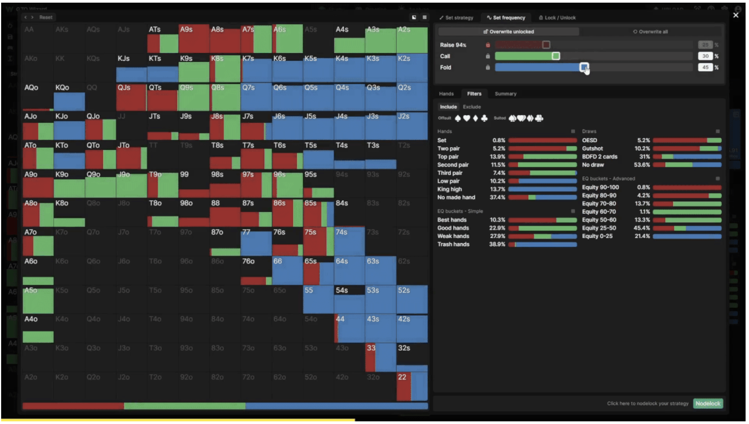

Slide 21
Hand Bucketing - Why?
Complexity Challenge
169 hole-card combos * 100s of board runouts ~ 10^71 decision nodes (for Heads Up)
Exact NE calculation is computationally intractable without heavy abstraction

Slide 22
Hand Bucketing - Techniques
Group hold cards with similar equity and strategic roles.
Then treat each bucket as a singular node in the tree
Trade-off: loss of precision, but core strategy preserved (similar to Kuhn Poker)

Slide 23
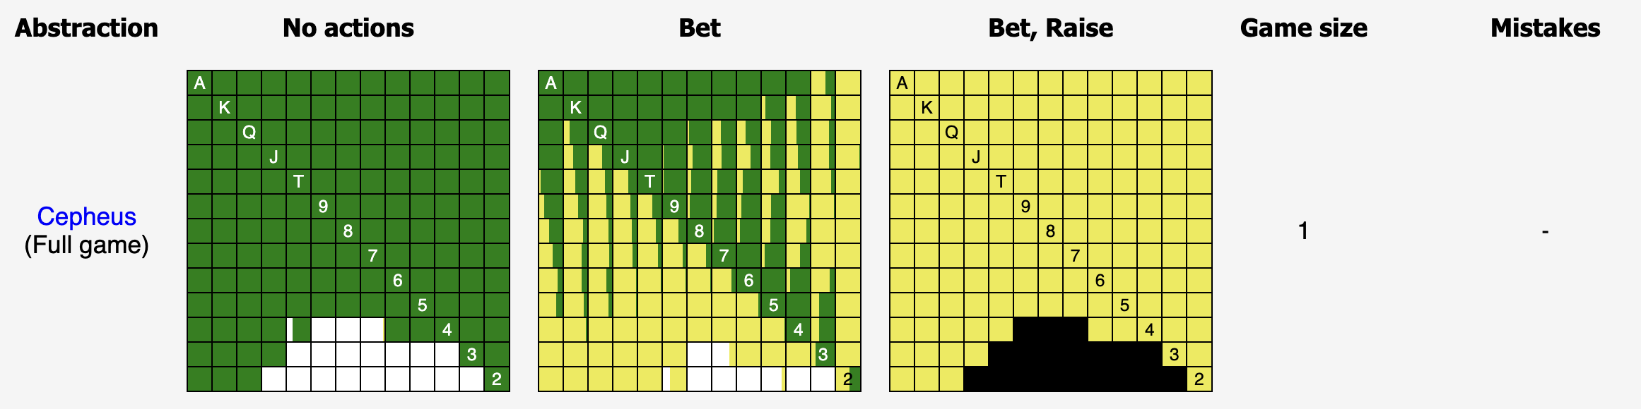
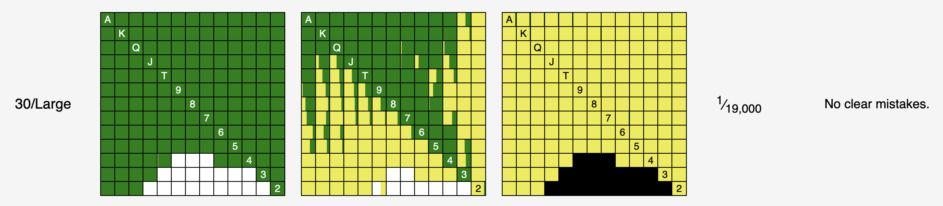
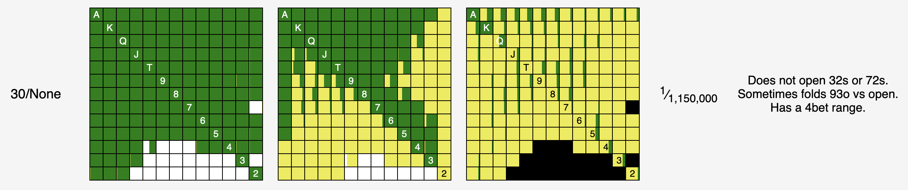
Hand Bucketing - Common Buckets
Premium hands: AA - QQ
Top broadway: AK - KQ
Suited connetors: JT - 76
Small pairs: 22 - 66
Rags: everything else
Abstraction results from MonkerSolver

Slide 24
GTO vs Exploitative
Strategic Goals
GTO: protect against perfect opponent
Exploitative: maximize vs opponent’s with known leaks
Reality: balance between theory and practice
In practice, over adjustment opens you up to counter exploitation (“leveling”)

Slide 25
Belief Revision in Poker
Bayes’ Theorem: P(θ|data) ∝ P(data|θ) P(θ)
θ = opponent’s action frequency (e.g., 3-bet rate)
Update beliefs as new hand data arrives

Slide 26
Bayesian Example
Prior θ = 5%
Observed k=3 3-bets in n=30 hands
Likelihood ∝ θ^k (1−θ)^(n−k)
Posterior normalized → approximately 8%

